Slide 1
Grid Computing

Slide 2
Definition
Grid computing is the collection of computer resources from multiple locations to reach a common goal.
Foster and Kesselman, 1998
“A computational grid is a hardware and software infrastructure that provides dependable, consistent, pervasive, and inexpensive access to high-end computational facilities”
“The goal is to create the illusion of a simple yet large and powerful self managing virtual computer out of a large collection of connected heterogeneous systems sharing various combinations of resources.”

Slide 3
Grid Computing
Grids are a form of distributed computing whereby a “super virtual computer” is composed of many networked loosely coupled computers acting together to perform very large tasks.
This technology has been applied to computationally intensive scientific, mathematical, and academic problems through volunteer computing.
Example applications:
drug discovery
economic forecasting
seismic analysis and
data processing/mining in support for e-commerce

Slide 4
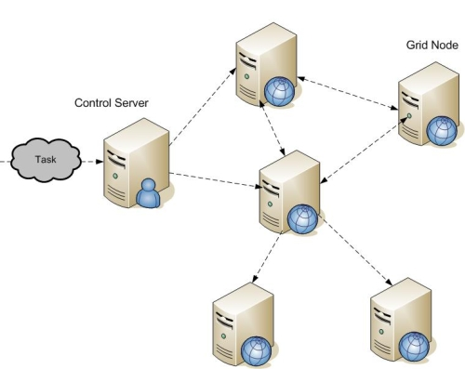
Grid Computing Architecture
Notes:
in distributed computing), a large number of discrete computers (e.g., laptops) distributed across a network (e.g., the Internet) devote some or all of their time to solving a common problem; each individual computer (client) receives and completes many small tasks, reporting the results to a central server which integrates the task results from all the clients into the overall solution.

Slide 5
Why do we need Grid Computing?
Various traditional computer architectural enhancements exist for increasing computer speed, network speeds, and storage capacity. However, we see a low utilization of computing power in a continuous manner
Need for fault-tolerance
Not all problems are solved efficiently by a single high-power computing unit
Grid Computing architecture presents an effective solution

Slide 6
Grid Computing Advantages
Exploiting underutilized resources
Parallel CPU and storage capacity
Virtual resources and virtual organizations for collaboration
Load balancing
Fault Tolerance
Reliability and Management

Slide 7
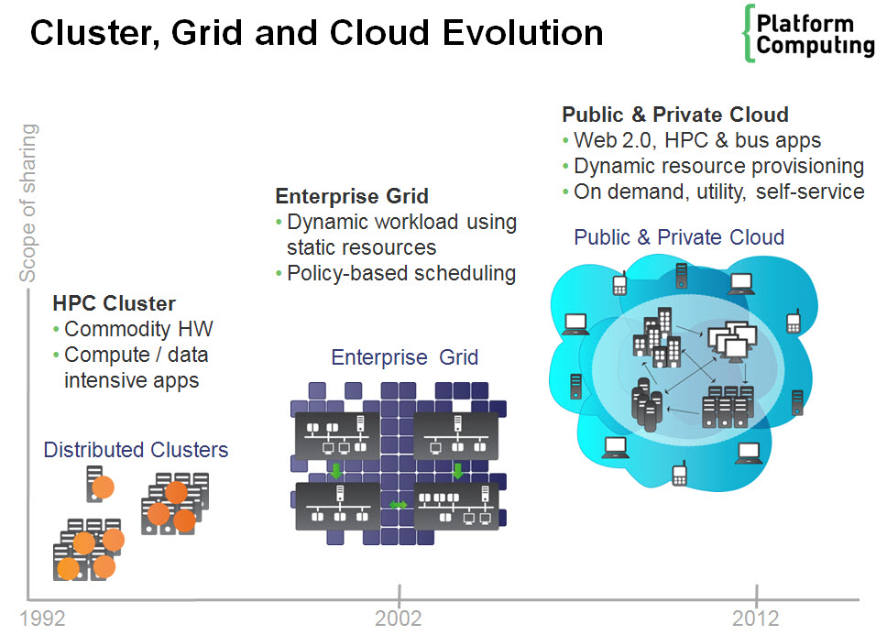
Grid Architecture Timeline
Notes:
High performance computing

Slide 8
Related technologies
Cluster computing
Peer-to-peer computing
Internet computing

Slide 9
Cluster computing
Idea: put some PCs together and get them to communicate
Cheaper to build than a mainframe supercomputer
Different sizes of clusters
Scalable – can grow a cluster by adding more PCs
Comparison Grid computing and cluster Computing?
http://www.answers.com/Q/Comparison_Grid_computing_and_cluster_Computing

Slide 10
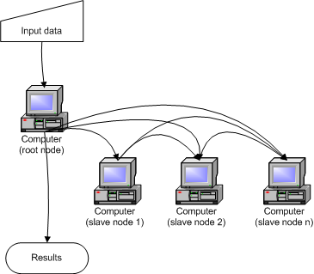
Cluster Architecture

Slide 11
Peer-to-Peer computing
Connect to other computers
Can access files from any computer on the network
Allows data sharing without going through central server
Decentralized approach also useful for Grid

Slide 12
Peer to Peer architecture

Slide 13
Internet computing
Idea: many idle PCs on the Internet
Can perform other computations while not being used
“Cycle scavenging” – rely on getting free time on other people’s computers
Example: SETI@home
Notes:
Global scientific project aimed at discovering life elsewhere in the universe through the detection of remote radio signals.
Currently the largest distributed computing effort with over 3 million users.

Slide 14
A typical view of Grid environment
Grid Information Service system collects the details of the available Grid resources and passes the information to the resource broker.
Grid Information Service
Details of Grid resources
1
4
2
3
Computational jobs
Grid application
Processed jobs
Computation result
User
Resource Broker
A User sends computation or data intensive application to Global Grids in order to speed up the execution of the application.
A Resource Broker distribute the jobs in an application to the Grid resources based on user’s QoS requirements and details of available Grid resources for further executions.
Grid Resources
Grid Resources (Cluster, PC, Supercomputer, database, instruments, etc.) in the Global Grid execute the user jobs.

Slide 15
Grid Middleware
Grids are typically managed by grid ware - a special type of middleware that enable sharing and manage grid components based on user requirements and resource attributes (e.g., capacity, performance)
Software that connects other software components or applications to provide the following functions:
Run applications on suitable available resources – Brokering, Scheduling
Provide uniform, high-level access to resources
Address inter-domain issues of security, policy, etc.
Provide application-level status
Monitoring and control

Slide 16
Grid Computing Architectures
Distributed Computing
High-throughput Computing
On-demand Computing
Data-intensive Computing
Collaborative Computing
Cloud Computing

Slide 17
Distributed Computing
Idea: aggregate computational resources to tackle problems that cannot be solved by a single system
Examples: climate modeling, computational chemistry

Slide 18
High-throughput Computing
High-throughput computing (HTC) is a term to describe the use of many computing resources over long periods of time to accomplish a computational task.
High performance computing (HPC) tasks are characterized as needing large amounts of computing power for short periods of time, whereas HTC tasks also require large amounts of computing, but for much longer times (months and years, rather than hours and days).
Examples: parameter studies, cryptographic problems
Notes:
There are many differences between high-throughput computing, high-performance computing (HPC), and many-task computing (MTC).
HPC tasks are characterized as needing large amounts of computing power for short periods of time, whereas HTC tasks also require large amounts of computing, but for much longer times (months and years, rather than hours and days). Therefore, the HTC field is more interested in how many jobs can be completed over a long period of time instead of how fast an individual job can complete

Slide 19
Cloud Computing
Cloud computing is computing in which large groups of remote servers are networked to allow centralized data storage and online access to computer services or resources.
Notes:
utility computing: basically virtual servers available over the Internet.

Slide 20
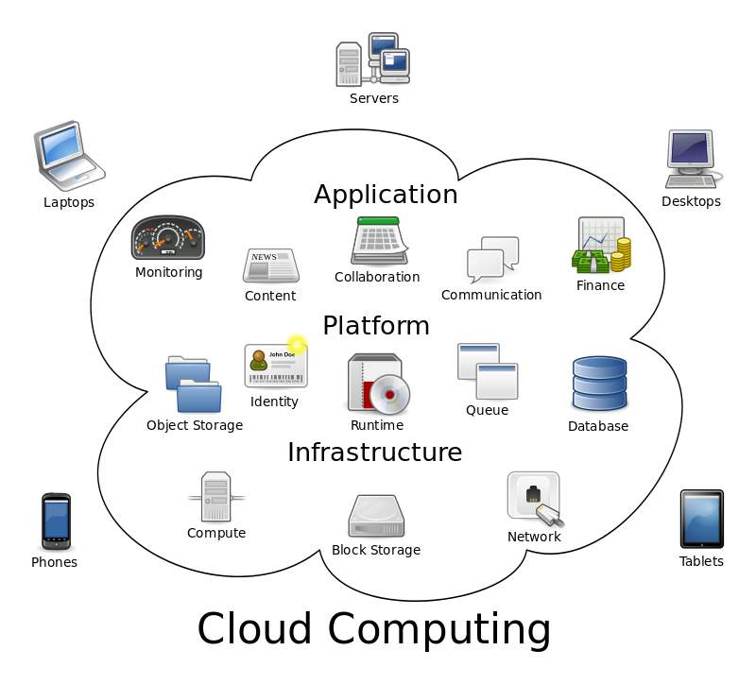
Cloud computing metaphor: For a user, the network elements representing the provider-rendered services are invisible, as if obscured by a cloud.

Slide 21
Cloud Computing
Cloud computing can be broken down into:
1. SaaS (software-as-a-service)
This type of cloud computing delivers a single application through the browser to thousands of customers.
Google Apps
Zoho Office
2. Utility computing
The idea is not new, but this form of cloud computing is getting new life from Amazon.com, Sun, IBM, and others who now offer storage and virtual servers that IT can access on demand.

